Slide 1
Contaminated Confessions Revisited
Research by Brandon L. Garrett, Professor of Law, University of Virginia School of Law
blg2n@eservices.virginia.edu
Presented by Gregory DeClue, Ph.D., ABPP
Forensic Psychologist
Sarasota, FL
http://gregdeclue.myakkatech.com
gregdeclue@me.com
941-951-6674

Slide 2
Inside Information Checklist
Gregory DeClue, PhD, ABPP (Forensic)
Independent Psychology Practice, Sarasota
http://gregdeclue.myakkatech.com
gregdeclue@me.com
941-951-6674
Charles “Skip” Rogers, Owner and Lead Instructor, The Interviews and Interrogations Institute
http://www.getconfessions.com/
confessiongetter@att.net

Slide 3
“When … the probative force of evidence depends on the circumstances in which it was obtained … indications of conscientious police work will enhance probative force and slovenly work will diminish it.” Kyles v. Whitley, 514 U.S. 419, 446 & n. 15 (1995).

Slide 4
Henry Lee McCollum
and
Leon Brown
Notes:
On September 2, 2014, North Carolina Superior Court Judge Douglas Sasser vacated the sentences of Henry Lee McCollum and Leon Brown and ordered that they be released. The two men had been convicted for the 1983 rape and murder of an 11-year-old girl. Evidence leading to McCollum’s and Brown’s releases included a DNA match to a man who has been convicted for a similar rape and murder in the same town. At the time of their release, McCollum had been on death row for 30 years, and Brown was serving a life sentence.
Both McCollum and Brown told confession stories to police during lengthy interrogations. Police records and testimony convinced juries and appellate courts, including the U.S. Supreme Court, that they were guilty. Police records and testimony were so convincing that, years later, Justice Scalia invoked McCollum’s case as a reason to continue to impose the death penalty in future cases. Now we know what the police did wrong in McCollum’s and Brown’s cases, and we know what police interrogators can do to prevent future wrongful convictions stemming from false confession stories. It is imperative that police agencies come to understand what we have learned from wrongful convictions, and then revise their policies and procedures as needed.

Slide 5
We have developed an interrogation framework that we expect will reduce wrongful convictions from police-induced false confessions to zero (or near zero), without reducing the number of true confessions.
A description of our procedure has survived peer review and will be published in an international police journal.
Police-interrogation trainers have begun to teach this framework.

Slide 6
Hey! We expect this to damn near eliminate wrongful convictions from police-induced false confessions! Without reducing the number of true confessions! This is gonna be published in an international police journal! And cops have already begun to teach police interrogators how to do it!

Slide 7
Brandon L. Garrett, Convicting the Innocent: Where Criminal Prosecutions Go Wrong (Cambridge, Mass.: Harvard University Press, 2011), 18–19;
and
Garrett, “The Substance of False Confessions,” Stanford Law Review, 62, no. 4 (2010): 1051–1119, http://www.stanfordlawreview.org/sites/default/files/articles/Garrett.pdf

Slide 8
40 false confession cases within the first 250 DNA exonerations
Notes:
“To my great surprise, when I analyzed these case materials I found that not just a few, but almost all, of these exonerees’ confessions were contaminated. I sought out trial materials and court records for all 40 exonerees who falsely confessed, and I was able to obtain them for all 40. I also located the text of written confession statements for most of these exonerees. All of those records provided a rich source of material.

Slide 9
All but 2 of the 40 exonerees studied told police much more than just ‘I did it.’
Notes:
Instead, police said that these innocent people gave rich, detailed, and accurate information about the crime, including what police described as ‘inside information’ that only the true culprit could have known.”

Slide 10
Instead, police said that these innocent people gave rich, detailed, and accurate information about the crime, including what police described as ‘inside information’ that only the true culprit could have known.”

Slide 11
Brandon L. Garrett, “Contaminated Confessions Revisited,” Virginia Law Review, Vol. 101, (2015 Forthcoming).
http://papers.ssrn.com/sol3/papers.cfm?abstract_id=2485536

Slide 12
 | Contaminated with Inside Information
 | Number | Percent
40 False Confessions (1989-2009) | 38 | 95%
26 False Confessions (2009-2014) | 24 | 92%
66 False Confessions (Total) | 62 | 94%
Notes:
Since that time, Garrett has continued to analyze known cases of false confessions, and the results continue to demonstrate the problem of contamination during police interrogation: “In just the last five years [2009 to 2014], there has been a new surge in false confessions—a set of 23 more false confessions among DNA exonerations.” All but two of these new cases of wrongful conviction show evidence of contamination during police interrogation. Again, police said that these innocent people gave rich, detailed, and accurate information about the crime, including what police described as ‘inside information’ that only the true culprit could have known.

Slide 13
 | Interrogation More than Three Hours
 | Number | Percent
40 False Confessions (1989-2009) | 36 | 90%
26 False Confessions (2009-2014) | 25 | 96%
66 False Confessions (Total) | 61 | 92%

Slide 14
 | Guilty Pleas
 | Number | Percent
40 False Confessions (1989-2009) | 10 | 25%
26 False Confessions (2009-2014) | 8 | 31%
66 False Confessions (Total) | 18 | 27%

Slide 15
 | Juveniles
 | Number | Percent
40 False Confessions (1989-2009) | 13 | 33%
26 False Confessions (2009-2014) | 10 | 38%
66 False Confessions (Total) | 23 | 35%

Slide 16
 | Intellectually Disabled or Mentally Ill
 | Number | Percent
40 False Confessions (1989-2009) | 17 | 43%
26 False Confessions (2009-2014) | 5 | 19%
66 False Confessions (Total) | 22 | 33%

Slide 17
 | Not a Juvenile, Not Identified as Intellectually Disabled or Mentally Ill
 | Number | Percent
40 False Confessions (1989-2009) | 14 | 35%
26 False Confessions (2009-2014) | 13 | 50%
66 False Confessions (Total) | 27 | 41%

Slide 18
16 of the 26 false confessions involved group confession cases in which multiple people falsely confessed, implicating themselves and sometimes also additional people, including some who did not confess.

Slide 19
All 66 of these DNA exonerees waived their Miranda rights.
Many waived their rights on video or in signed statements.
Judges then affirmed the voluntariness of the confession statement in every case in which the admissibility of the evidence was challenged.

Slide 20
Considering all DNA exonerations to date, 20 exonerees had been sentenced to death.
10 (half) of them had falsely confessed.

Slide 21
(The National Registry of Exonerations includes over 178 exonerations that involved confessions, the majority of which were non-DNA exonerations. --
% Exonerations by Contributing Factor, National Registry of Exonerations,
https://www.law.umich.edu/special/exoneration/Pages/ExonerationsContribFactorsByCrime.aspx)

Slide 22
Inside Information Checklist
Gregory DeClue, PhD, ABPP (Forensic)
Independent Psychology Practice, Sarasota
http://gregdeclue.myakkatech.com
gregdeclue@me.com
941-951-6674
Charles “Skip” Rogers, Owner and Lead Instructor, The Interviews and Interrogations Institute
http://www.getconfessions.com/
confessiongetter@att.net

Slide 23
Safeguards

Slide 24
DeClue, G., & Rogers, C. S. (2012). Interrogations 2013: Safeguarding against false confessions. The Police Chief: The Professional Voice of Law Enforcement, October Issue, pages 42, 44, 46.

Slide 25
Investigate before you interrogate.
  a. Develop the details of the accusation or crime from physical evidence, the victim’s statement, the witnesses’ statements, and so forth.
  b. Make a substantial, written list of key details that are not publicly available and would be difficult or impossible for a noninvolved person to guess. Also list details that are unknown to police prior to the interrogation, but would likely be known by the perpetrator.
  c. Set the list aside and avoid mentioning any of those details to the suspect at any time.

Slide 26
2. Electronically record the entire interrogation, beginning as close to initial contact as possible and continuing well after the suspect makes admissions (if he or she does).

Slide 27
3. If the suspect makes admissions, elicit a detailed post-admission narrative (who, what, when, where, and how), taking special care not to suggest any details to the suspect.

Slide 28
4. After the interrogation has concluded, continue the investigation to seek additional details of the accusation or crime. Do the facts independently corroborate the confession statement?

Slide 29
5. Carefully consider whether independently derived details of the accusation or the crime match the details provided in the suspect’s confession statement. Does the suspect’s statement reveal knowledge of inside information?

Slide 30
DeClue, G., & Rogers, C. S. (in press). The Inside Information Checklist (IIC), The Police Chief: The Professional Voice of Law Enforcement.
Notes:
Imagine that, in a particular case, the police investigated before they interrogated. The police developed both parts of a Holdback List, listing some known details that would be kept secret from the public, witnesses, persons of interest, and suspects; and also listing unknown details that the true perpetrator would likely know. After completing the Holdback List, a detective engaged the suspect in an interview/interrogation, and the suspect eventually made an admission. The detective continued the interview/interrogation, asking nonleading questions to elicit a detailed post-admission narrative. That is, the detective encouraged the suspect to tell the complete story in his own words. The entire interaction between the suspect and police was electronically recorded. Now what?
What we want to know is, did the suspect provide inside information regarding the details of the crime? Did the suspect include some or all of the Known Details that were included on the Holdback List? If so, which of those details were never mentioned by the police during their interaction with the suspect? Did the suspect provide the details in response to open-ended questions, or only in response to leading questions? For each detail provided by the suspect, was the detail an accurate match to independently collected evidence?
Did the suspect provide information regarding details not known by the police prior to the interview/interrogation? If so, has subsequent investigation corroborated the suspect’s story? Does each detail provided by the suspect accurately match independent evidence, or not?

Slide 31
The Holdback List

Slide 32
“Prior to an interview, and preferably before any contact with the suspect, the investigator should attempt to become thoroughly familiar with all the known facts and circumstances of the offense.”
Inbau, F. E., Reid, J. E., Buckley, J. P., & Jayne, B. C. (2011). Criminal Interrogation and Confessions, Fifth Edition. Burlington, MA: Jones & Bartlett Learning. Page 10.

Slide 33
“Upon arriving at a crime scene, the lead investigator should decide and document on the case folder what information will be kept secret.” - p. 355

Slide 34
“After a suspect has related a general acknowledgment of guilt, the investigator should return to the beginning of the crime and attempt to develop information that can be corroborated by further investigation. He should seek from the suspect full details of the crime and also information about his subsequent activities. …

Slide 35
… What should be sought particularly are facts that would only be known by the guilty person (for example, information regarding the location of the murder weapon or the stolen goods, the means of entry into the building, the type of accelerant used to start the fire, and the type of clothing on the victim, etc.).”
- p. 306

Slide 36
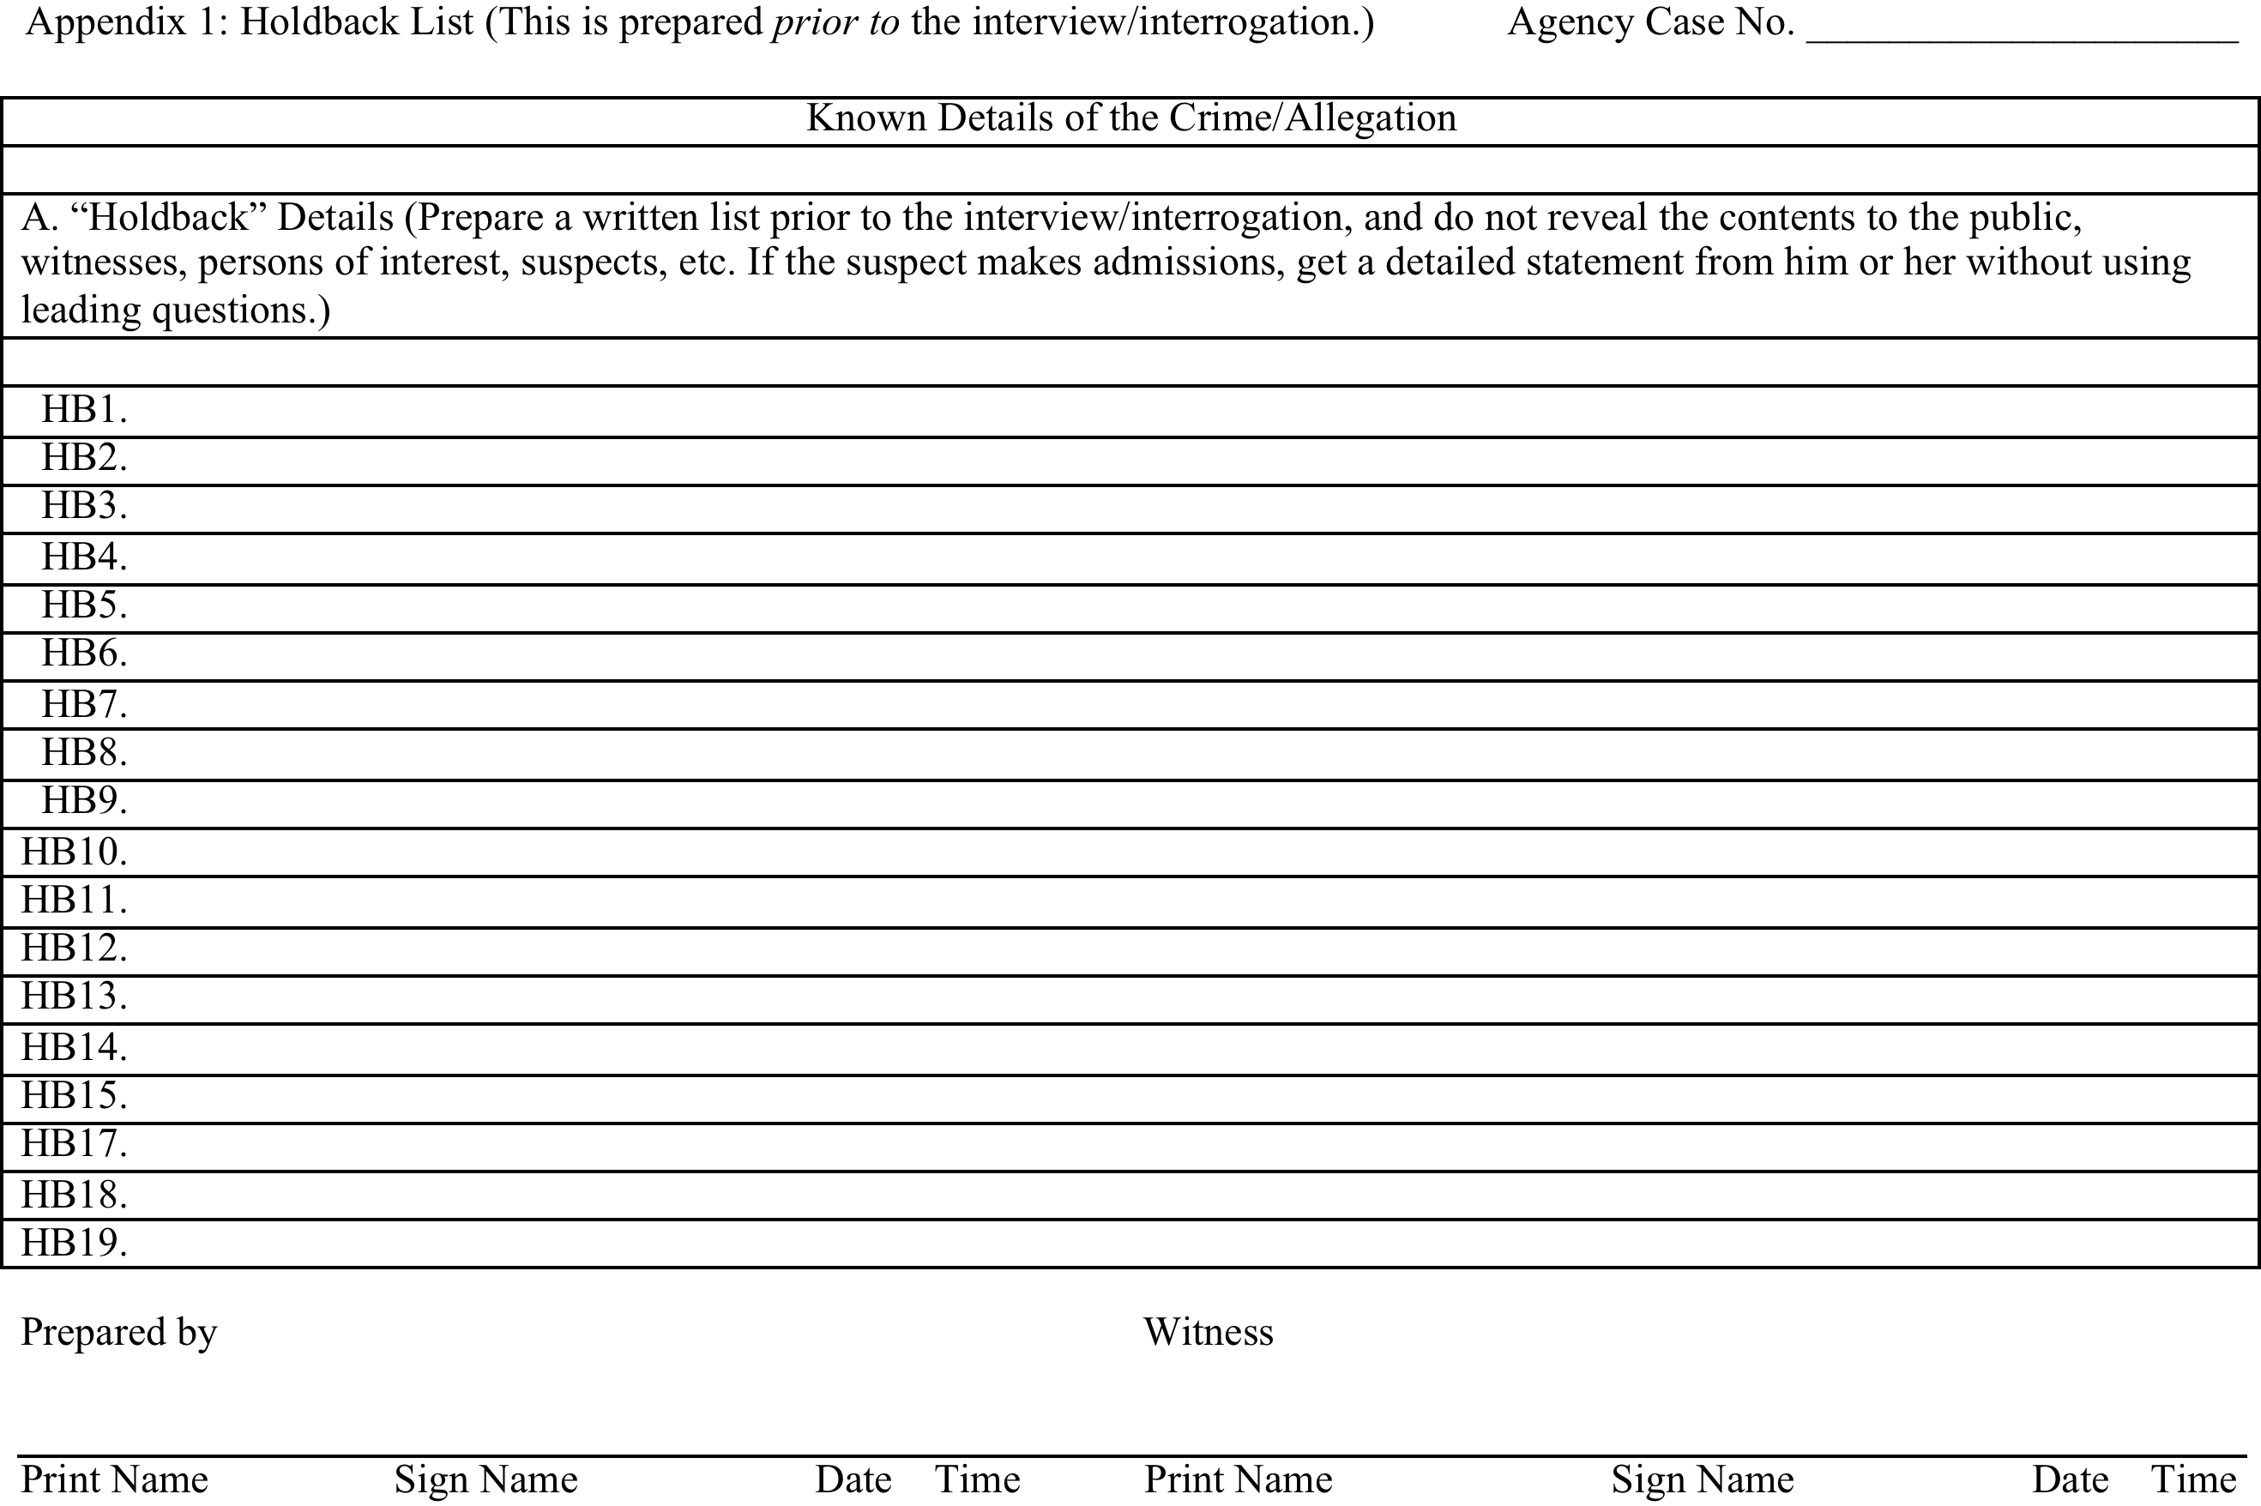

Slide 37
HB1. Victim was shot in the back of the head with a small-caliber weapon.
HB2. Victim’s hands were bound in the back.
HB3. The binding was done with duct tape.
HB4. The victim had a small superficial laceration to the left side of the throat.
HB5. The victim had “defensive” wounds on both hands.
Notes:
The first part, Known Details of the Crime/Allegation, includes details known to police prior to the interview/interrogation. These details can come from witness statements, crime-scene photos, direct observations by police officers of the crime scene, etc.

Slide 38
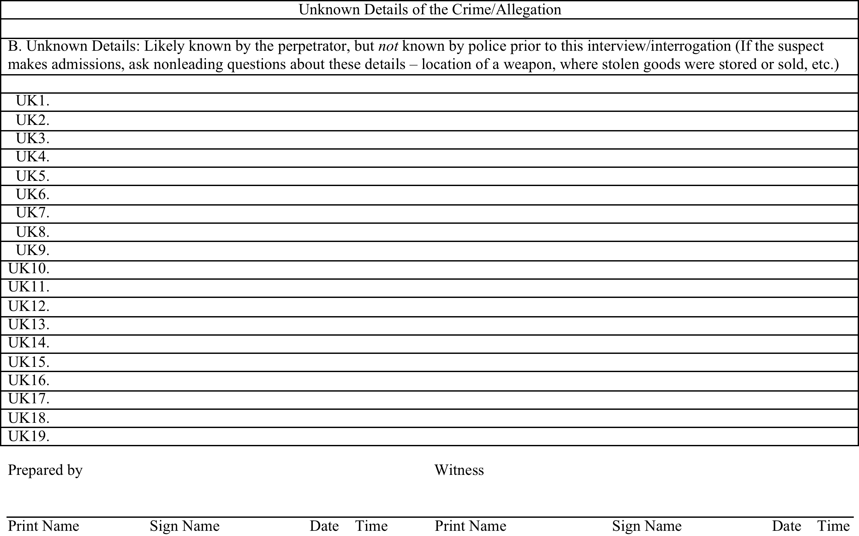

Slide 39
Examples
the location of a weapon used in the crime
the location of stolen goods that were stored or sold
when and where the suspect purchased items that were used in the commission of the crime
Notes:
The second part of the Holdback List, Unknown Details of the Crime/Allegation, is a list of details that a true perpetrator would likely know, but are not known to the police at the time of the interview/interrogation.
After the investigator completes the Holdback List, he or she signs it, noting the date and the time, and has a witness do the same. This helps to show that the Holdback List was actually completed prior to the beginning of the interview/interrogation. In custodial interviews, that fact can also be preserved on the recording itself. When the lights are turned on in the interview room and the recording is started, prior to bringing the suspect into the room, the investigator can hold the Holdback List up to the room’s camera for a few seconds, and then read the Holdback List aloud.

Slide 40
The Disk

Slide 41
Only 1 of the 66 exonerees in Garrett’s combined studies had an interrogation recorded in its entirety (and that person was unable to say anything about the crime beyond, “I guess I did it”).

Slide 42
“Recording entire interrogations is an important first step.”
Garrett’s careful analysis of the case files shows why this is an essential step.

Slide 43
“A total of 94%, or 62 of 66 false confessions by DNA exonerees to date, were contaminated by such allegedly ‘inside’ information. Almost without exception, these confession statements were contaminated with crime scene details which these innocent suspects, as we now know, could not have themselves been familiar with until they learned of them from law enforcement.”

Slide 44
“In these recent exonerations, the detectives similarly denied having disclosed any such information to the exonerees when asked by the defense about the source of the details contained in the confession statements; they did so in all but one of the fourteen cases in which there was a trial. After all, police training on the subject is very clear: one does not ask leading questions or disclose key facts concerning the crime. The leading manual on police interrogations … has long been emphatic that officers are to withhold from the public key facts and then ask nonleading questions to solicit that information, without disclosing them to the suspect.”

Slide 45
In 20 of these most recent 26 cases, the suspects’ confession statements included some facts inconsistent with crime scene information. “Had there been complete recordings of the interrogation statements, one might have been able to observe that, when asked nonleading questions, these innocent people volunteered incorrect information, and that they could only offer correct information when prompted. Absent such a recording, prosecutors could and did argue that these people were purposefully lying about some aspects of the crime, but that the ‘inside information’ they offered betrayed their guilt.”
Notes:
Only by carefully examining the contents of a complete recording of police contact with a suspect can we know which, if any, details were first mentioned by the suspect. This is particularly effective when a written Holdback List appears on camera near the beginning of the recording and the investigator reads the Holdback List aloud; then the suspect enters the room and is continuously recorded (including at least audio recording of restroom breaks or other times out of the interview room); the police never mention items on the Holdback List; and the suspect accurately reports details consistent with the Holdback List in response to nonleading questions and/or the suspect provides details unknown to the police prior to the interview/interrogation but corroborated by subsequent investigation.

Slide 46
The Inside Information Checklist
Notes:
Imagine that, in a particular case, the police investigated before they interrogated. The police developed both parts of a Holdback List, listing some known details that would be kept secret from the public, witnesses, persons of interest, and suspects; and also listing unknown details that the true perpetrator would likely know. After completing the Holdback List, a detective engaged the suspect in an interview/interrogation, and the suspect eventually made an admission. The detective continued the interview/interrogation, asking nonleading questions to elicit a detailed post-admission narrative. That is, the detective encouraged the suspect to tell the complete story in his own words. The entire interaction between the suspect and police was electronically recorded. Now what?
What we want to know is, did the suspect provide inside information regarding the details of the crime? Did the suspect include some or all of the Known Details that were included on the Holdback List? If so, which of those details were never mentioned by the police during their interaction with the suspect? Did the suspect provide the details in response to open-ended questions, or only in response to leading questions? For each detail provided by the suspect, was the detail an accurate match to independently collected evidence?
Did the suspect provide information regarding details not known by the police prior to the interview/interrogation? If so, has subsequent investigation corroborated the suspect’s story? Does each detail provided by the suspect accurately match independent evidence, or not?

Slide 47
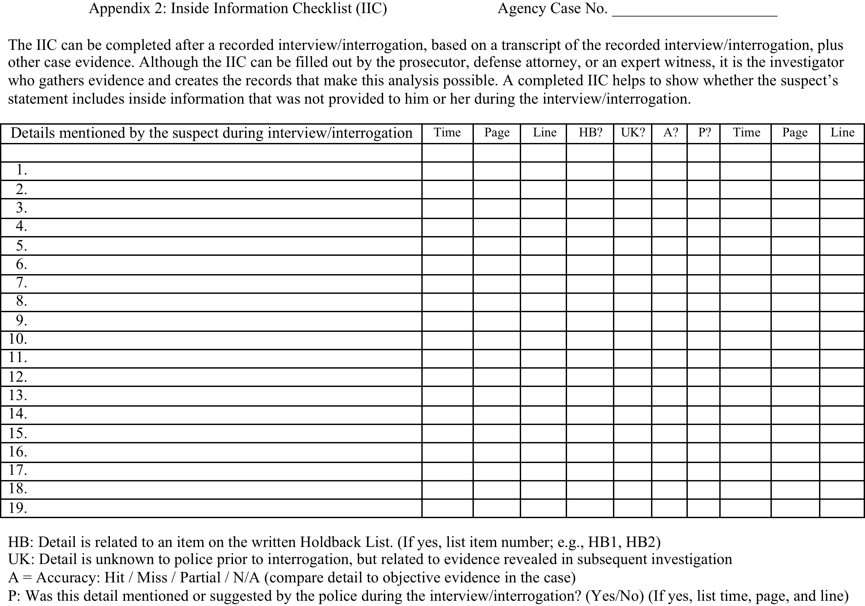
Notes:
If the police have conducted the investigation conscientiously, these are very straightforward questions. The Inside Information Checklist (Appendix 2) provides a way to organize the details of an investigation, including the details of the suspect’s statement, so that we can see whether the suspect provided accurate, independently verified details that show that he knew inside information about a crime to which he has confessed.

Slide 50
Generally, we expect that, when a suspect gives a voluntary, true confession during police interrogation, the suspect should be able to provide accurate inside information. If he cannot provide accurate details, that raises serious doubts about the reliability of his statement. If he will not provide accurate details, that may raise questions about whether he is providing a voluntary confession.

Slide 51
Conscientious or Slovenly Work?

Slide 52
Three questions that can guide police, prosecutors, defense attorneys, expert witnesses, judges, and juries as they consider confession evidence:
What’s on the Holdback List?
What’s on the Disk?
What’s on the IIC?

Slide 53
Among DNA exonerees, nearly every wrongful conviction stemming from a false confession has been due in large part to contamination during the interview/interrogation.

Slide 54
We now know a straightforward procedure to avoid such wrongful convictions in present and future cases:
Develop a Holdback List,
Electronically record the entire interaction.
Use an Inside Information Checklist to determine whether the suspect’s confession story shows knowledge of inside information.

Slide 55
“The ultimate test of the trustworthiness of a confession is its corroboration. The admissions, ‘I shot and killed Mr. Johnson’ or ‘I forced Susie Adams to have sex with me’ may be elicited from an innocent juvenile or adult suspect. These admissions only become useful as evidence if they are corroborated by (1) information about the crime the suspect provides which was purposefully withheld from the suspect and/or, (2) information not known by the police until after the confession which is subsequently verified.” – Inbau et al., 2011, p. 255

Slide 56
90.702 Testimony by experts.—If scientific, technical, or other specialized knowledge will assist the trier of fact in understanding the evidence or in determining a fact in issue, a witness qualified as an expert by knowledge, skill, experience, training, or education may testify about it in the form of an opinion or otherwise, if:
(1) The testimony is based upon sufficient facts or data;
(2) The testimony is the product of reliable principles and methods; and
(3) The witness has applied the principles and methods reliably to the facts of the case.

Slide 57
Kumho Tire Company v. Carmichael
526 U.S. 137 (1999)

Slide 58
3.9(b) DEFENDANT’S STATEMENTS
A statement claimed to have been made by the defendant outside of court has been placed before you. Such a statement should always be considered with caution and be weighed with great care to make certain it was freely and voluntarily made.
Therefore, you must determine from the evidence that the defendant’s alleged statement was knowingly, voluntarily, and freely made.
In making this determination, you should consider the total circumstances, including but not limited to
whether, when the defendant made the statement, [he] [she] had been threatened in order to get [him] [her] to make it, and
whether anyone had promised [him] [her] anything in order to get [him] [her] to make it.
If you conclude the defendant’s out of court statement was not freely and voluntarily made, you should disregard it.

Slide 59
As Justice Souter wrote in Corley v. United States 556 U.S. 303, 321 (2009), “There is mounting empirical evidence that [custodial police interrogation] can induce a frighteningly high percentage of people to confess to crimes they never committed.”

Slide 60
Within the total circumstances, a relevant consideration is whether police interrogators in a particular case
employed procedures recommended by police interrogation trainers to ensure that the suspect’s statement will be voluntary and reliable and/or
employed procedures that police interrogation trainers recommend not be used by police interrogators.

Slide 61
The U.S. Supreme Court has found police interrogation training manuals to be reliable sources of what police interrogators do, and of what police interrogation trainers recommend.

Slide 62
“A valuable source of information about present police practices, however, may be found in various police manuals and texts which document procedures employed with success in the past, and which recommend various other effective tactics. These texts are used by law enforcement agencies themselves as guides. It should be noted that these texts professedly present the most enlightened and effective means presently used to obtain statements through custodial interrogation. By considering these texts and other data, it is possible to describe procedures observed and noted around the country.”
- Miranda v. Arizona 384 U.S. 436 (1966), Note 9

Slide 63
Criminal Interrogation and Confessions was used extensively by the U.S. Supreme Court in the Miranda decision, and is cited in Footnotes 9, 10, 12, 13, 15-17, and 20-23.

Slide 64
The 3rd edition of Criminal Interrogation and Confessions was used by the U.S. Supreme Court as a reliable source of information about police interrogation practices in
Missouri v. Seibert 542 U.S. 600 (2004) and in
Stansbury v. California 511 U.S. 318 (1994).

Slide 65
Do police interrogation trainers recognize that police interrogation can lead to false confessions?

Slide 66
“There is no question that interrogations have resulted in false confessions from innocent suspects.” – CIC, p. 339.
“There is no question that innocent suspects have been induced to confess to crimes they did not commit.” – CIC, p. 366.

Slide 67
Do police interrogation trainers recommend that police refrain from using particular interrogation techniques/tactics, due to an increased risk of eliciting an involuntary or unreliable confession story?

Slide 68
“All interrogations that result in a confession involve an incentive. There are legally permissible incentives, which would not be apt to cause an innocent person to confess, and others that are not permissible.” – CIC, p. 348.
“Our longstanding position has been that interrogation incentives that are apt to cause an innocent person to confess are improper.” – CIC, p. 344

Slide 69
“It is imperative … that the investigator limit theme concepts to moral justifications or rationalizations concerning the crime. If the theme presents threats of inevitable consequences coupled with promises of leniency, it could jeopardize the validity of the confession. Similarly, an interrogation theme should, in no way, attempt to convince the suspect that he is guilty of the crime under investigation. These and other factors … potentially affect the voluntariness or trustworthiness of a confession.” – CIC, p. 203

Slide 70
“The investigator must avoid any expressed or specific statement to the effect that, because of the minimized seriousness of the offense, leniency will be afforded. … At no time should the investigator state, or imply, that the suspect will receive such leniency.” – CIC, p. 213

Slide 71
“At no time … should the investigator suggest or state that the suspect’s use of alcohol or drugs caused him to ‘black out’ and forget that he committed the crime.” – CIC, p. 215

Slide 72
“An interrogation theme should not absolve the suspect from legal consequences associated with his crime.” – CIC, p. 219

